Slide 1
CONTROLLING

Slide 2
QUESTIONS TO BE ANSWERED
How coordination plays an important role in successful management?
What is the nature of coordination? Give its features.
How controlling acts as a management function in organisation’s efficient functioning? ( process)
What are the features of controlling and what are its different types?
What are the different techniques of controlling? Explain each in detail.
A. budgeting,
B. break-even analysis,
C. human resource accounting,
D. social audit,
E. Inventory control (EOQ, LIFO-FIFO,ABC Analysis)
F.PERT/CPM Analysis,
G. TQM.
6.“ Planning and controlling are like inseparable twins”. Elaborate the statement.

Slide 3
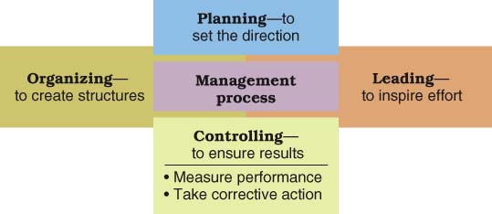
CONTROLLING
Controlling
  The process of measuring performance and taking action to ensure desired results.

Slide 4
THE MEANING OF CONTROL
Control, including quality control, also involves office productivity, such as improved customer service, elimination of bottlenecks, and reduction in paperwork mistakes. Lack of effective control can seriously damage an organization’s health and threaten its future. Organizational control is the systematic process through which managers regulate organizational activities to make them consistent with the expectations established in plans, targets, and standards of performance. To effectively control an organization, managers (or workers) require information about performance standards, actual performance, and actions to correct deviations from the standards.

Slide 5
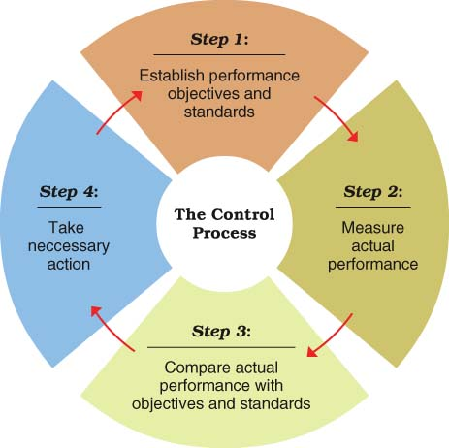
CONTROL AND CONTROL SYSTEMS
Control Systems
Output Standard
  Measures performance results in terms of quantity, quality, cost, or time.
Input Standard
  Measures work efforts that go into a performance task

Slide 6
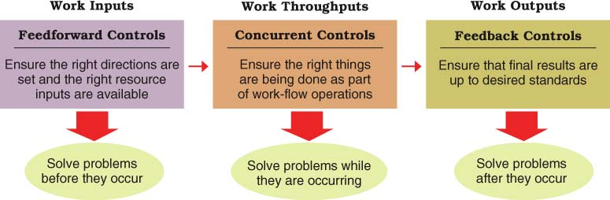
Types Of Control Systems

Slide 7
Core Control System
Strategic plans
Financial forecasts
Budgets
Management by objectives
Operations management techniques
MIS reports
Form an integrated system for directing and monitoring organizational activities.
Notes:
2

Slide 8
Strategic Plan
Financial Forecast
Targets, standards
Notes:
3

Slide 9
Strategic Plan
Financial Forecast
Management by Objectives
Performance Appraisal Systems
Targets, standards
Notes:
4

Slide 10
Strategic Plan
Financial Forecast
Management by Objectives
Performance Appraisal Systems
Operations Management
System
Targets, standards
Notes:
5

Slide 11
Strategic Plan
Financial Forecast
Management by Objectives
Performance Appraisal Systems
Operations Management
System
Operating
Budget
Targets, standards
Notes:
6

Slide 12
Strategic Plan
Financial Forecast
Management by Objectives
Performance Appraisal Systems
Operations Management
System
Operating
Budget
Management
Information
Systems
Targets, standards
Notes:
7

Slide 13
Strategic Plan
Financial Forecast
Management by Objectives
Performance Appraisal Systems
Operations Management
System
Operating
Budget
Manufacturing
or Service
Operations
Management
Information
Systems
Targets, standards
Notes:
8

Slide 14
Strategic Plan
Financial Forecast
Management by Objectives
Performance Appraisal Systems
Operations Management
System
Operating
Budget
Manufacturing
or Service
Operations
Management
Information
Systems
Targets, standards
Information on performance
Notes:
9

Slide 15
CONTROLLING TECHNIQUES
BUDGETING
PERT/CPM
TQM
BREAK-EVEN ANALYSIS
INVENTORY CONTROL
HUMAN RESOURCE ACCOUNTING(HRA)
SOCIAL AUDIT

